Slide 1
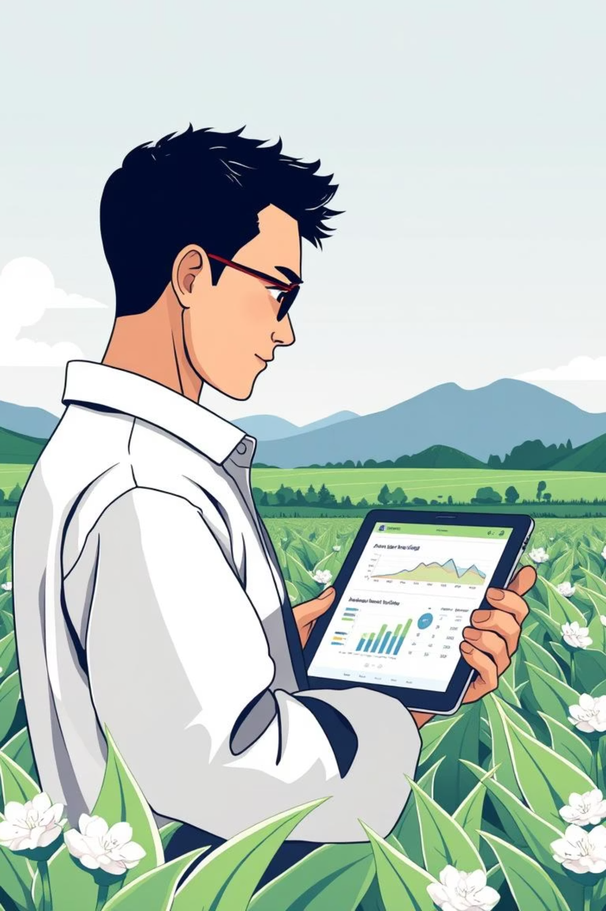
AI Crop Planner for Small Farmers
Empowering small farmers with smart, data-driven decisions for sustainable and profitable farming.

Slide 2
Agenda
01
02
The Challenge & Our Solution
Key Features & Tech Stack
Addressing the core needs of small farmers.
How we bring intelligence to farming decisions.
03
04
User Experience: From Input to Insight
Impact & Next Steps
A walk-through of the farmer-friendly interface.
Vision for a thriving agricultural future.

Slide 3
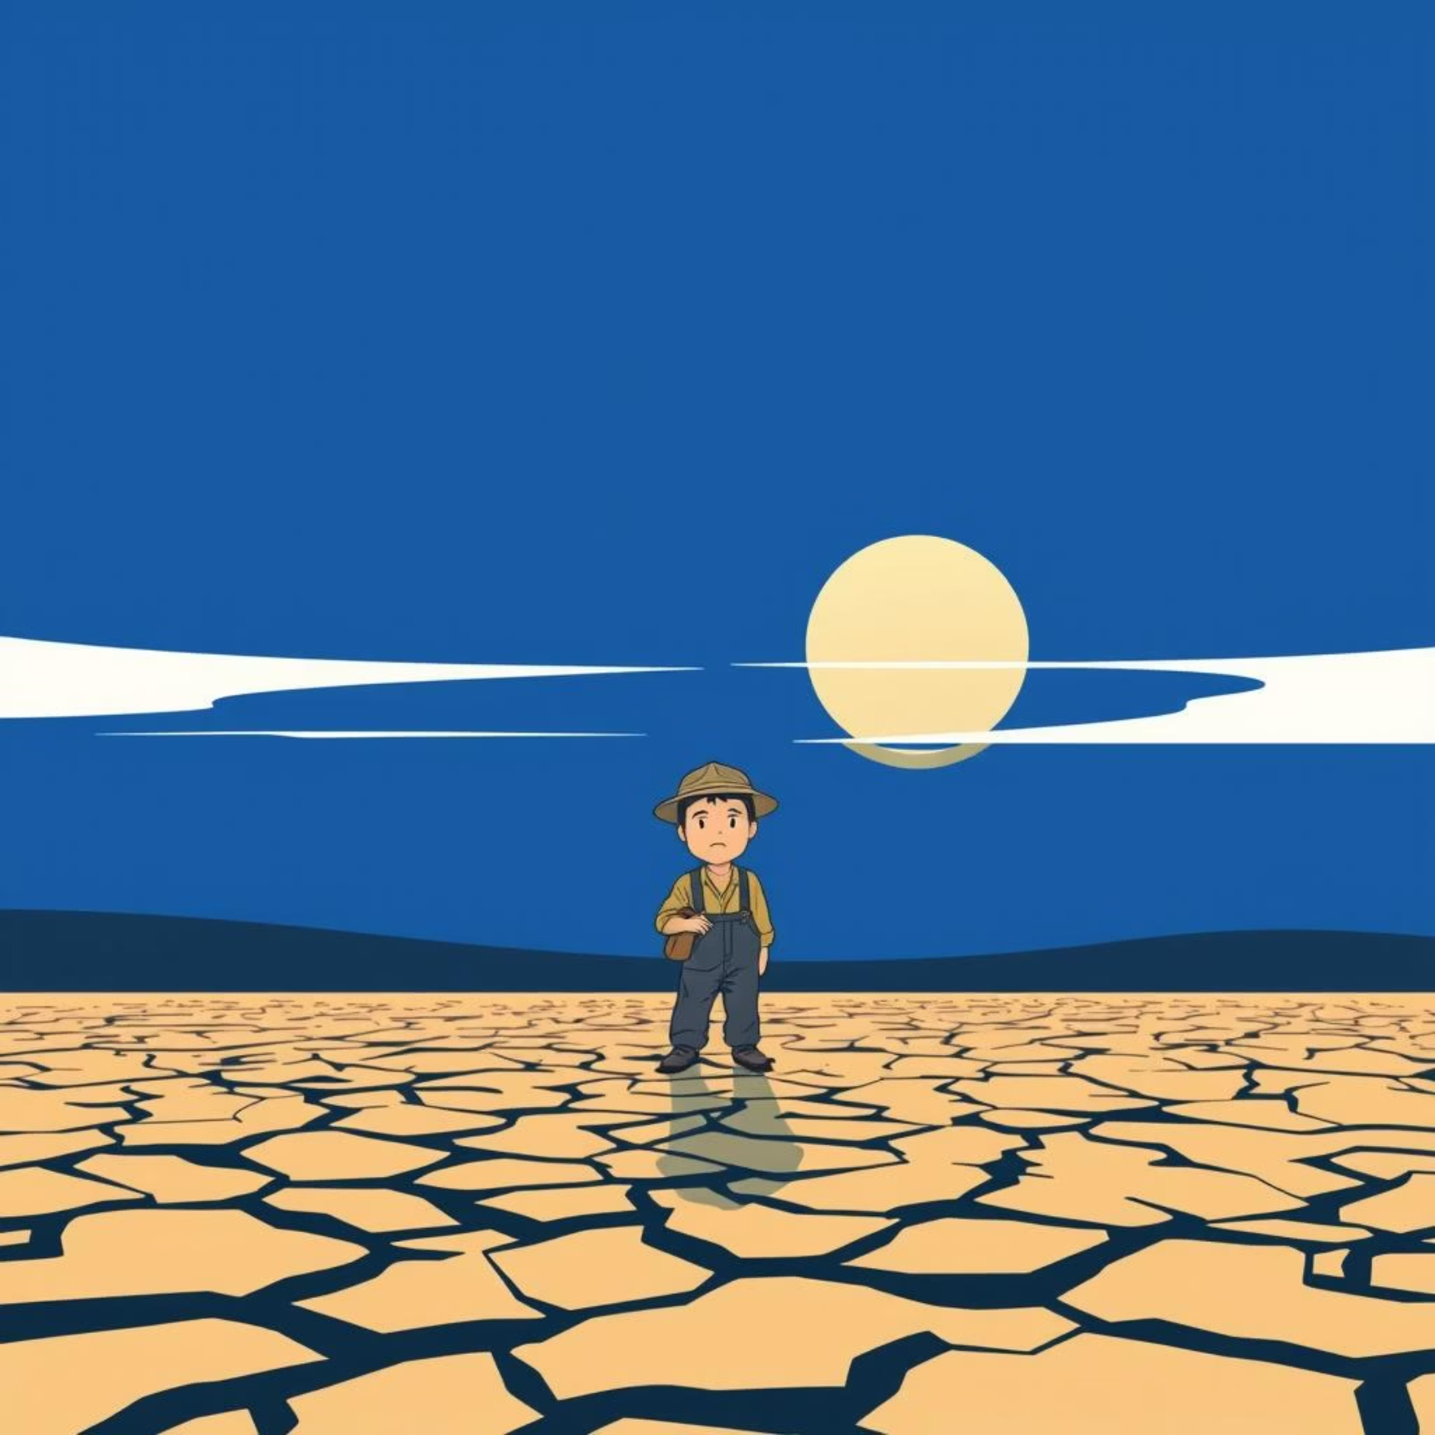
Navigating the complex world of farming decisions.
Small farmers often rely on traditional knowledge, which can be vulnerable to unpredictable weather, changing market dynamics, and evolving soil conditions. Making informed decisions about what to plant is crucial for yield and profitability, yet often lacks precise data.

Slide 4
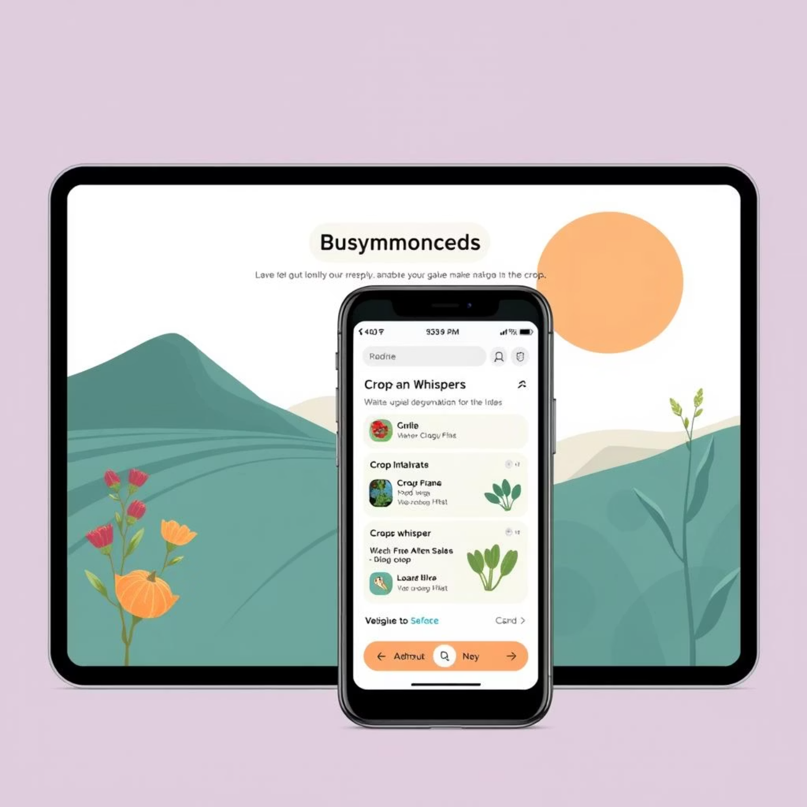
Introducing: AI Crop Planner
Our AI Crop Planner is a responsive web application designed to empower small farmers with data-driven insights. By analyzing key agricultural factors, it provides intelligent crop recommendations to optimize yields and boost profits.
Smart Recommendations
Real-time Data
Farmer-Friendly Interface
Analyzes soil, irrigation, land size, and location.
Integrates live weather and market price trends.
Simple, intuitive design for easy use on any device.

Slide 5
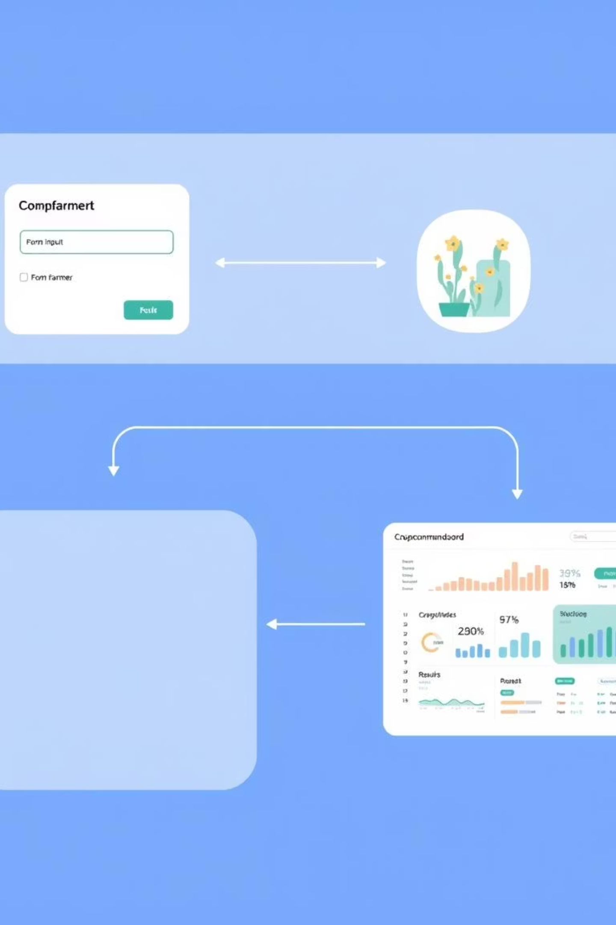
How it works: A seamless user journey
1
1. Farmer Input Form: Farmers enter details like location, land size, soil type, and irrigation method into a simple form.
2
2. Backend Processing: Our Flask API receives the input, fetches real-time weather and market data, and applies a smart recommendation engine.
3
3. Instant Recommendations: The app generates personalized crop suggestions, expected yields, and market insights.
4
4. Interactive Dashboard: Farmers view a clean dashboard with weather widgets, crop cards, and yield graphs.

Slide 6




The Tech Behind the Harvest
Frontend: React + TailwindCSS
Backend: Flask (Python)
Delivering a responsive, mobile-first UI with a clean, intuitive user experience.
Robust REST API endpoints for data processing and recommendation generation.
Database: SQLite/PostgreSQL
APIs: RapidAPI & Market Data
Secure storage for farmer inputs, preferences, and generated recommendations.
Integrating real-time weather forecasts and market price trends for informed decisions.

Slide 7
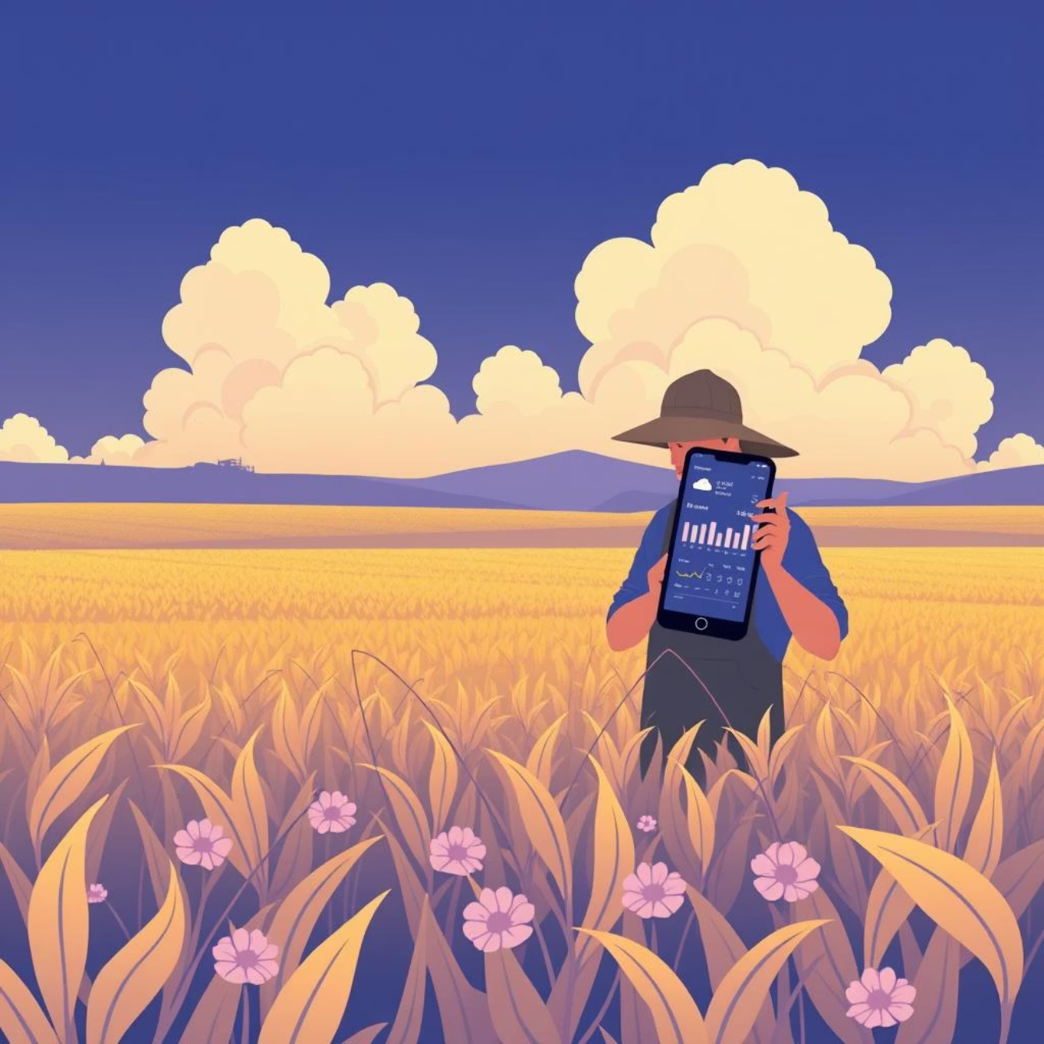
Data-Driven Insights for Every Farmer
Real-time Weather
1
Fetches temperature, rainfall, humidity, and wind speed via RapidAPI for precise planning.
Market Price Trends
2
Integrates market data (via mock/free API) to identify the most profitable crops.
Intelligent Recommendation Engine
3
Combines soil suitability, climate, and market profitability for tailored suggestions.
Responsive & Multilingual UI
4
Optimized for mobile use (English + Hindi placeholder) to reach more farmers.

Slide 8
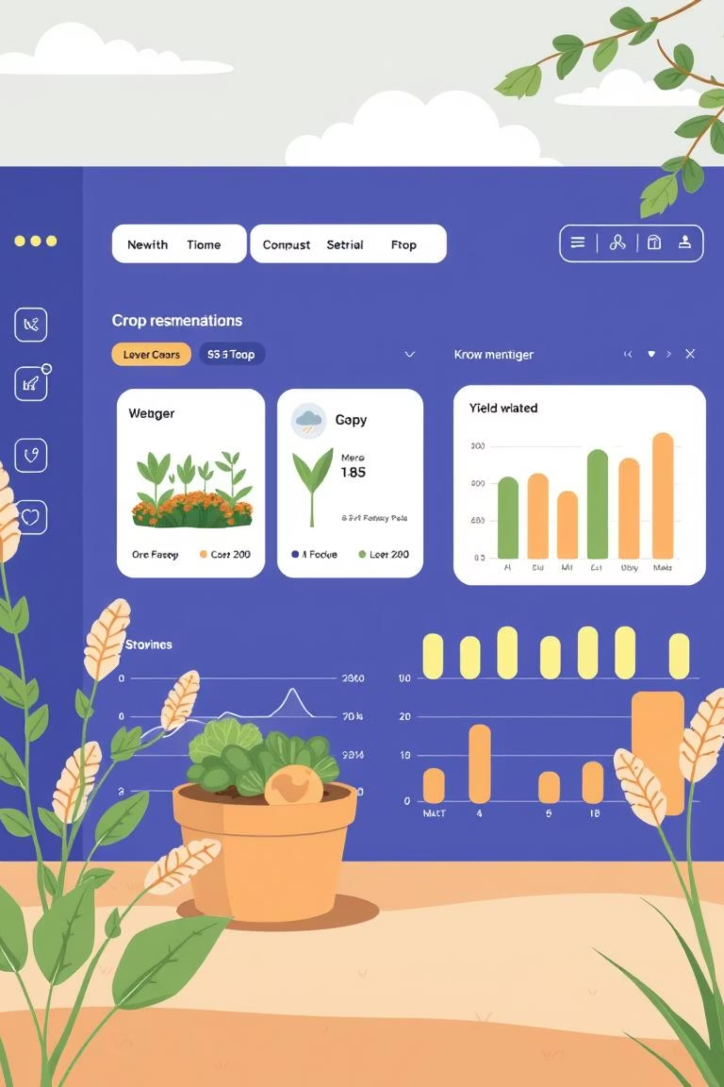
Visualizing Success: The Results Dashboard
Crop Recommendation Cards
Interactive Visuals
Real-time Weather Widget
Crop Name
Yield Graph (Predicted vs. Average)
Reason for Recommendation
Expected Yield Estimate
Alerts Section (e.g., rainfall, pest risks)
Current Market Price

Slide 9




Next Steps & Call to Action
Pilot Program Launch
Expand API Integrations
Partner with small farming communities for real-world testing and feedback.
Integrate with more diverse data sources for soil, climate, and localized market prices.
Enhance Recommendation Engine
Community & Language Expansion
Evolve to include advanced machine learning models for even more precise recommendations.
Roll out to more regions and support additional local languages to maximize reach.
Let's cultivate a future where every small farmer thrives.

